Slide 1
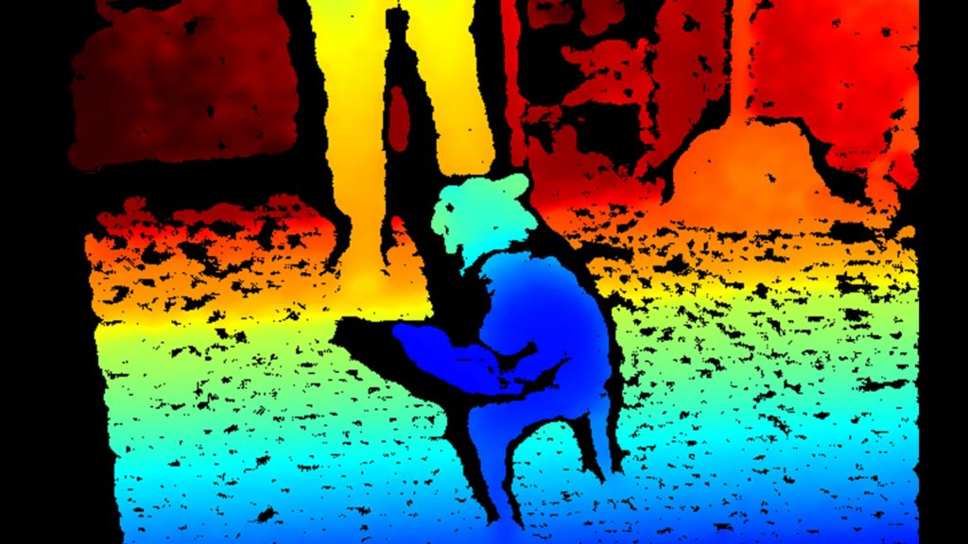
Stereo

Slide 2
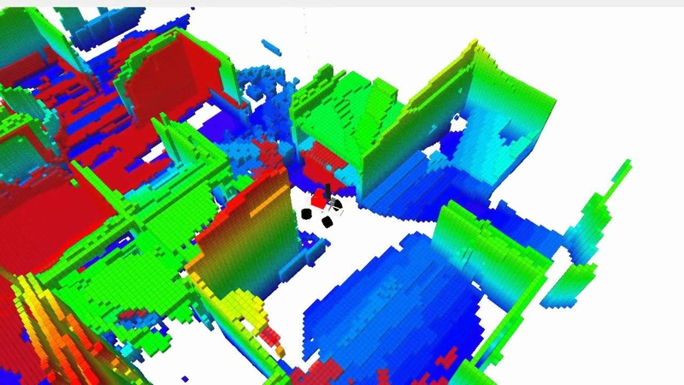
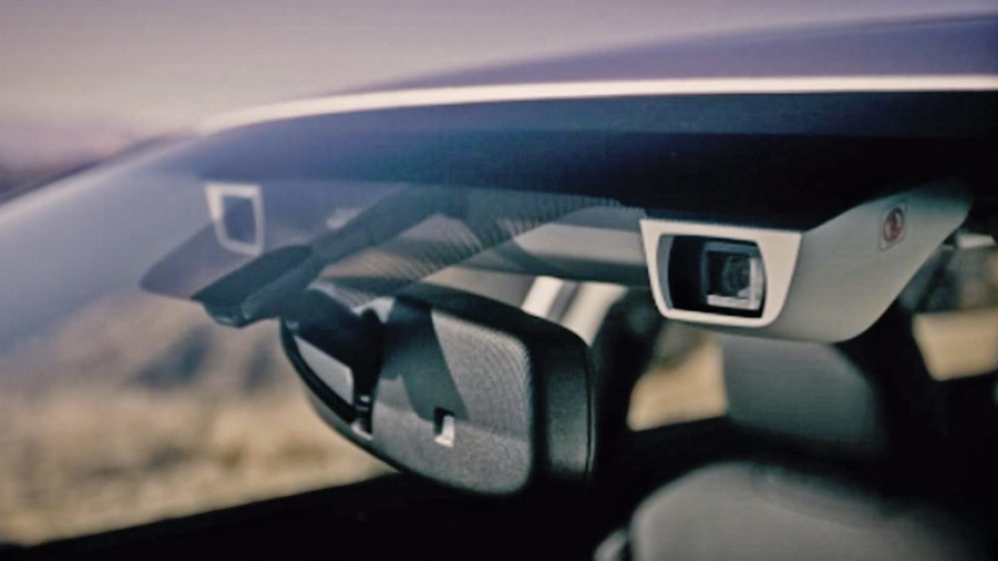
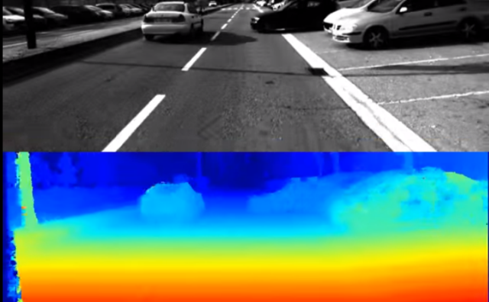
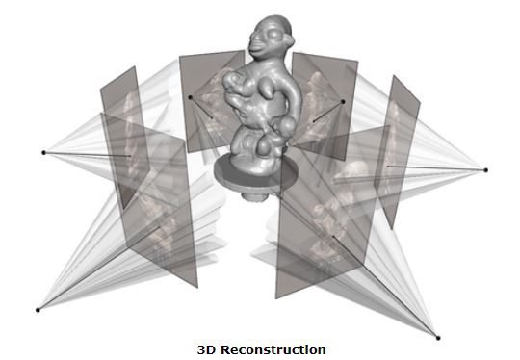
What can be done with stereo vision?
SLAM- robot navigation
Autonomous driving
3D reconstruction

Slide 3
References
http://szeliski.org/Book/
http://www.cs.cornell.edu/courses/cs5670/2019sp/lectures/lectures.html
http://www.cs.cmu.edu/~16385/

Slide 4
Contents
structure from motion
Epipolar geometry
Essential matrix
Fundamental matrix
Estimating the fundamental matrix
Camera rectification
Triangulation
Stereo matching
Other 3D sensors

Slide 5
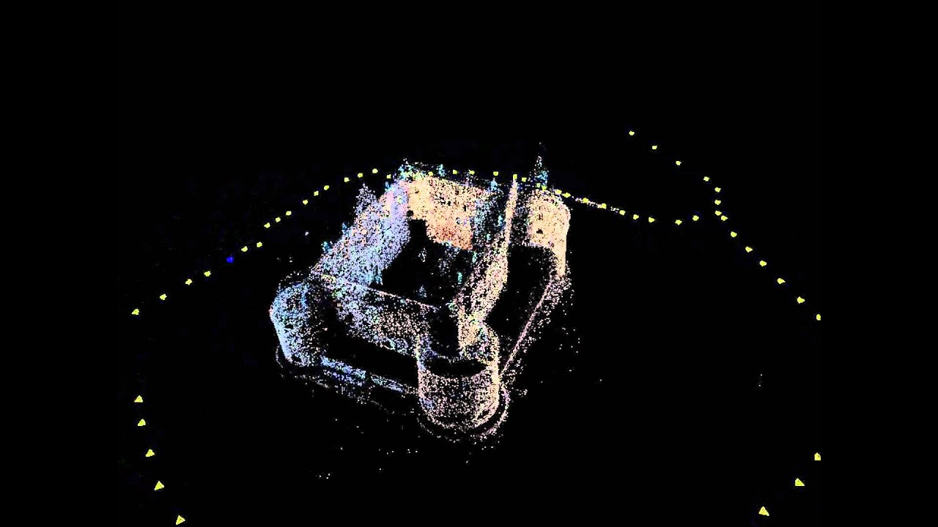
Structure from motion
Structure from motion (SfM) is the process of estimating the 3-D structure of a scene from a set of 2-D images. SfM is used in many applications, such as 3-D scanning and augmented reality.
[Mathworks]
SfM is also known as 3D reconstruction.
Stereo vision is a subcategory of SfM in which we are dealing only with 2 images.

Slide 6
Structure and motion
 | Structure (3D model of world) | Motion (6 DOFs of cameras) | Measurements
Pose Estimation (camera pose estimation) | known | estimate | 3D to 2D correspondences
Triangulation | estimate | known | 2D to 2D correspondences
3D reconstruction/ SfM/ stereo vision | estimate | estimate | 2D to 2D correspondences + triangulation

Slide 7
Structure and motion
So essentially one can say that “structure from motion” is the wrong name…
Structure and motion is more precise, but nobody will understand what are you talking about.
In this class we will learn about 3D reconstruction from two cameras (and triangulation as a sub topic).

Slide 8
Contents
structure from motion
Epipolar geometry
Essential matrix
Fundamental matrix
Estimating the fundamental matrix
Camera rectification
Triangulation
Stereo matching
Other 3D sensors

Slide 9
Epipolar geometry
Epipolar geometry is the geometry of stereo vision. When two cameras view a 3D scene from two distinct positions, there are a number of geometric relations between the 3D points and their projections onto the 2D images that lead to constraints between the image points.
[Wikipedia]

Slide 10
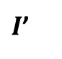
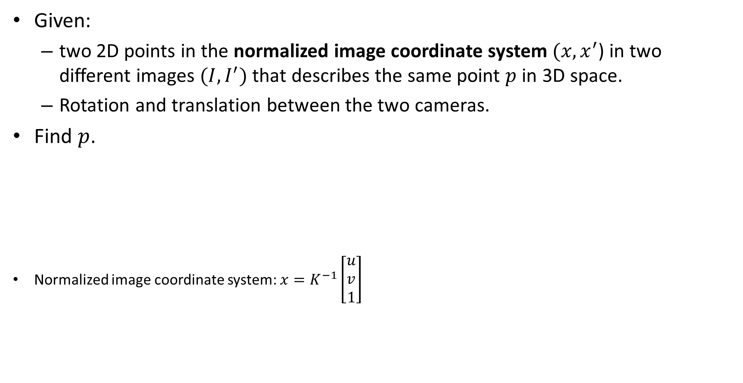
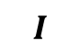
Epipolar geometry - The triangulation problem
Given:
two 2D points in the normalized image coordinate system $(x,x^{′}$) in two different images $(I,I^{′})$ that describes the same point $p$ in 3D space.
Rotation and translation between the two cameras.
Find $p$.
Normalized image coordinate system: ${x=K}^{−1}\left[\begin{aligned}u \\ v \\ 1\end{aligned}\right]$
$$I$$
$I$’

Slide 11


Epipolar geometry
$$I$$
$I$’

Slide 12
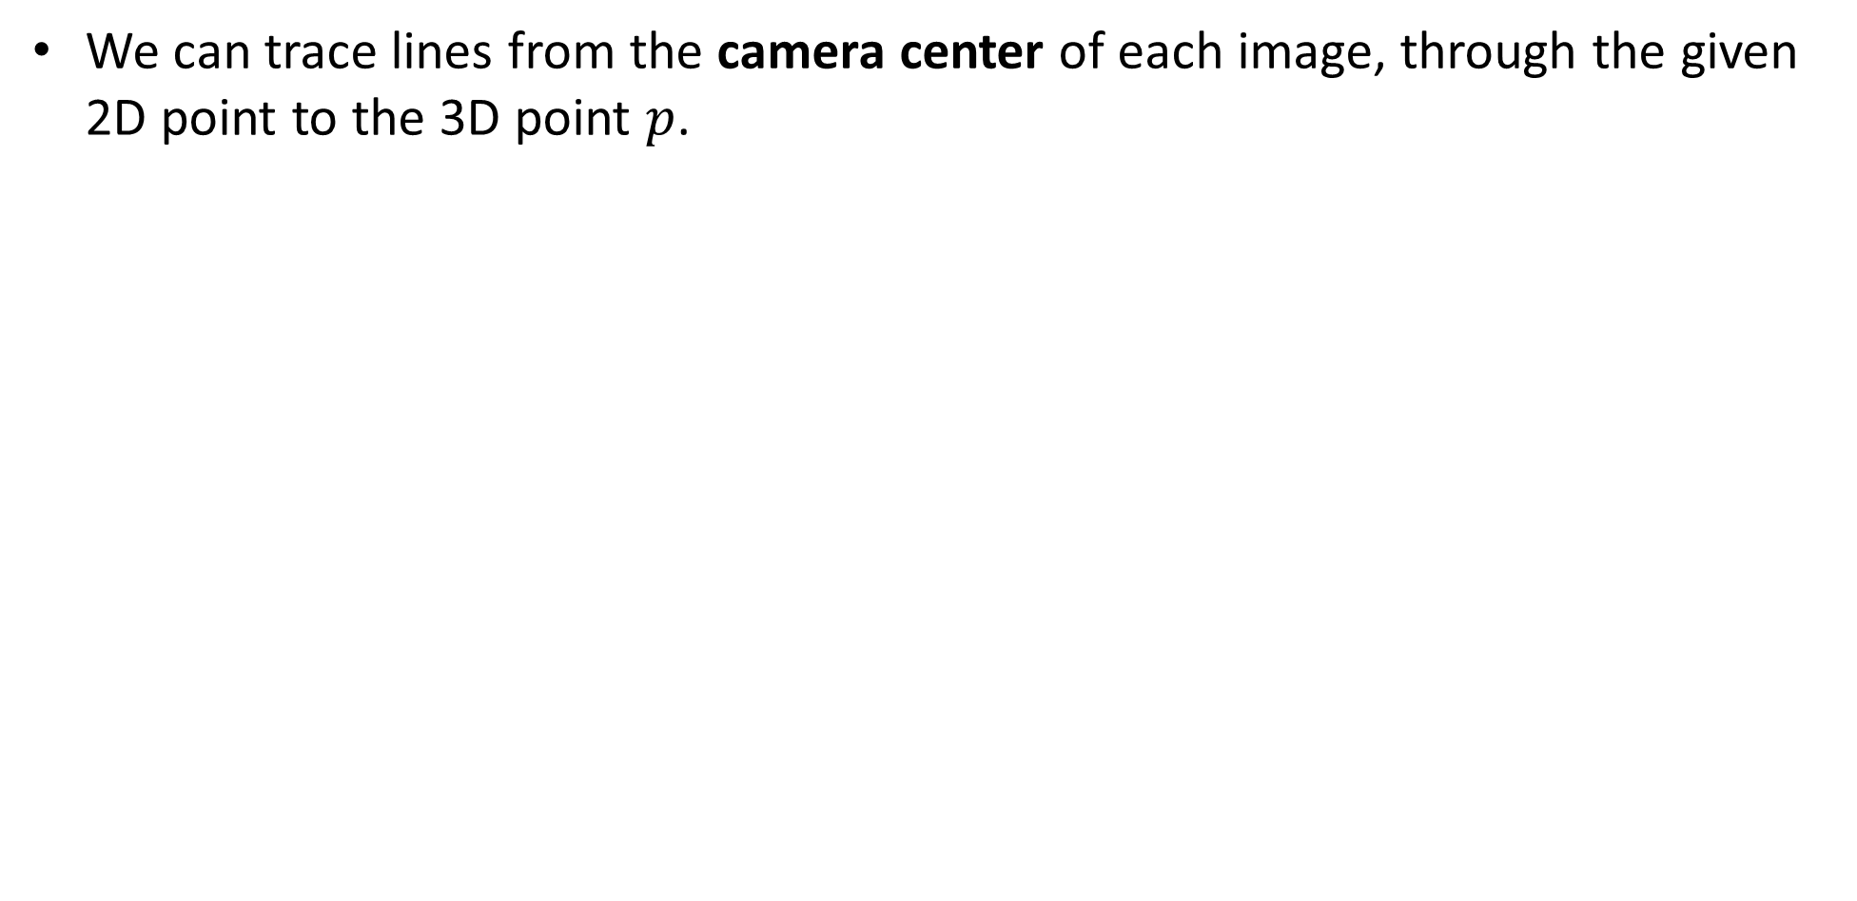
Epipolar geometry
We can trace lines from the camera center of each image, through the given 2D point to the 3D point $p$.
Camera center
$$I$$
$I$’

Slide 13
Epipolar geometry
Baseline is a vector that represent the translation between two cameras
Baseline
$$I$$
$I$’

Slide 14
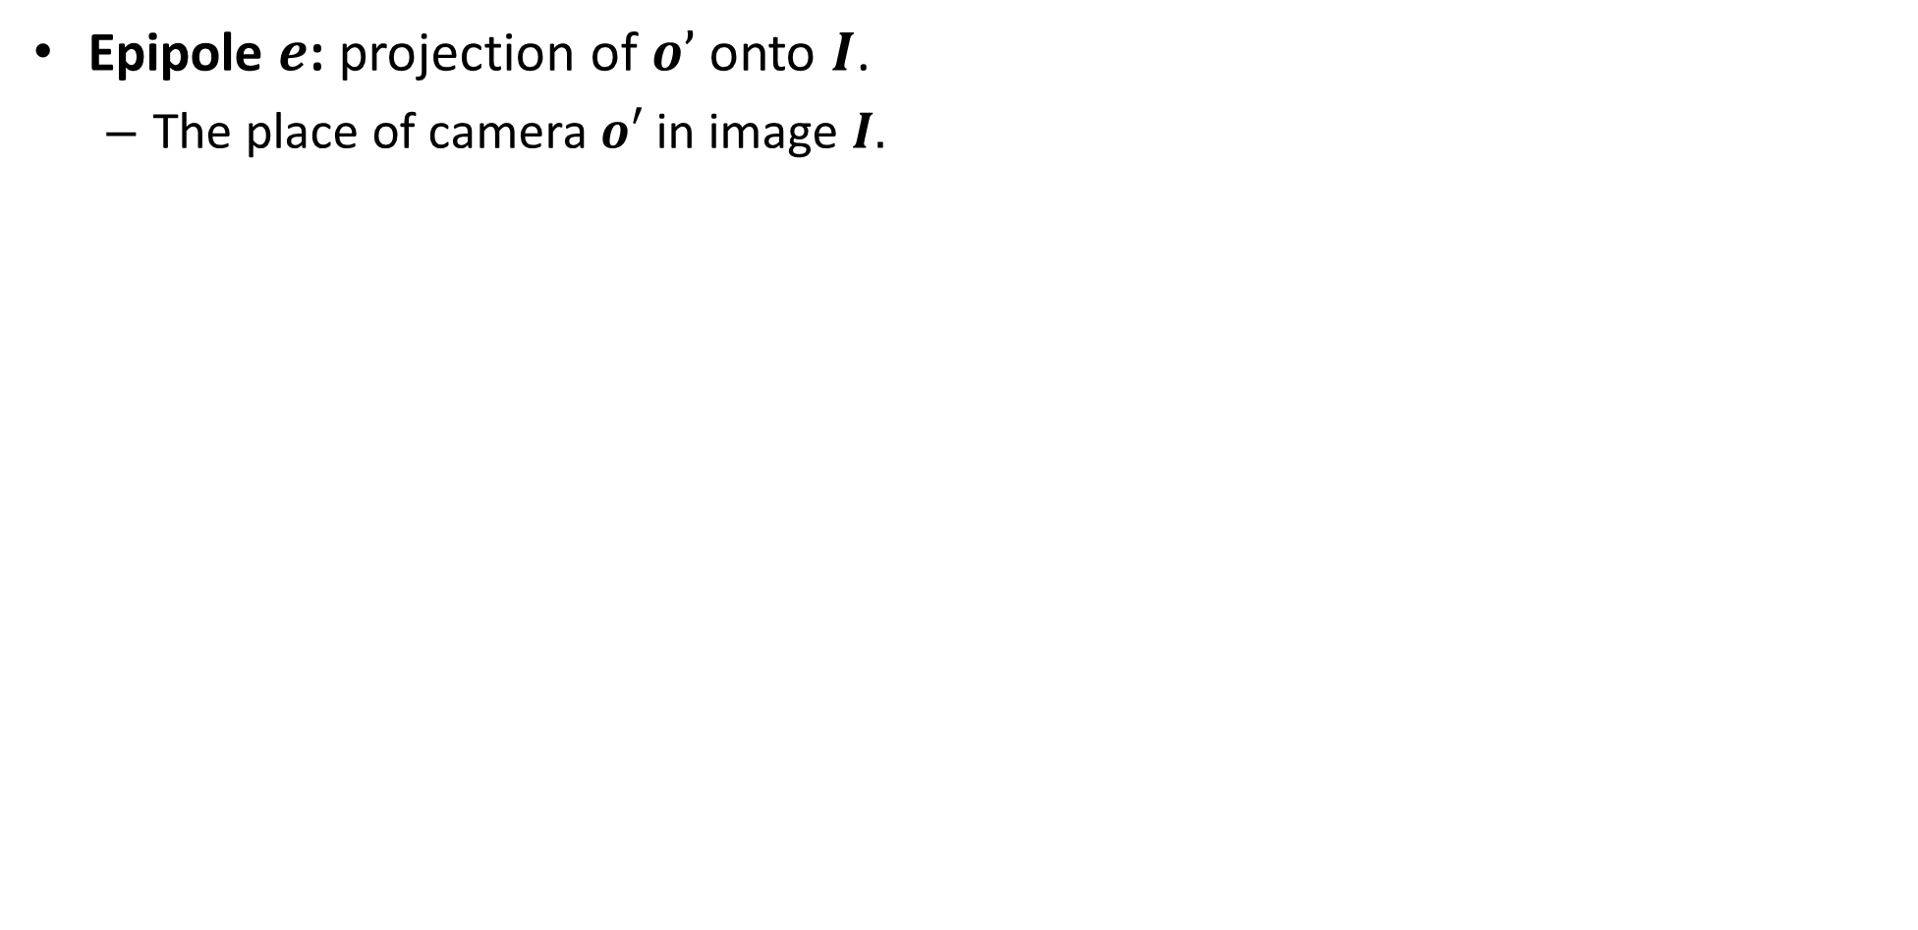

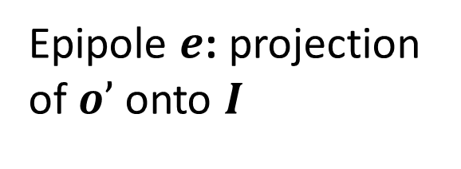
Epipolar geometry
Epipole $e$: projection of $o’$onto $I$.
The place of camera $o′$ in image $I.$
Epipole $e$: projection of $o’$onto $I$
$$I$$
$I$’

Slide 15
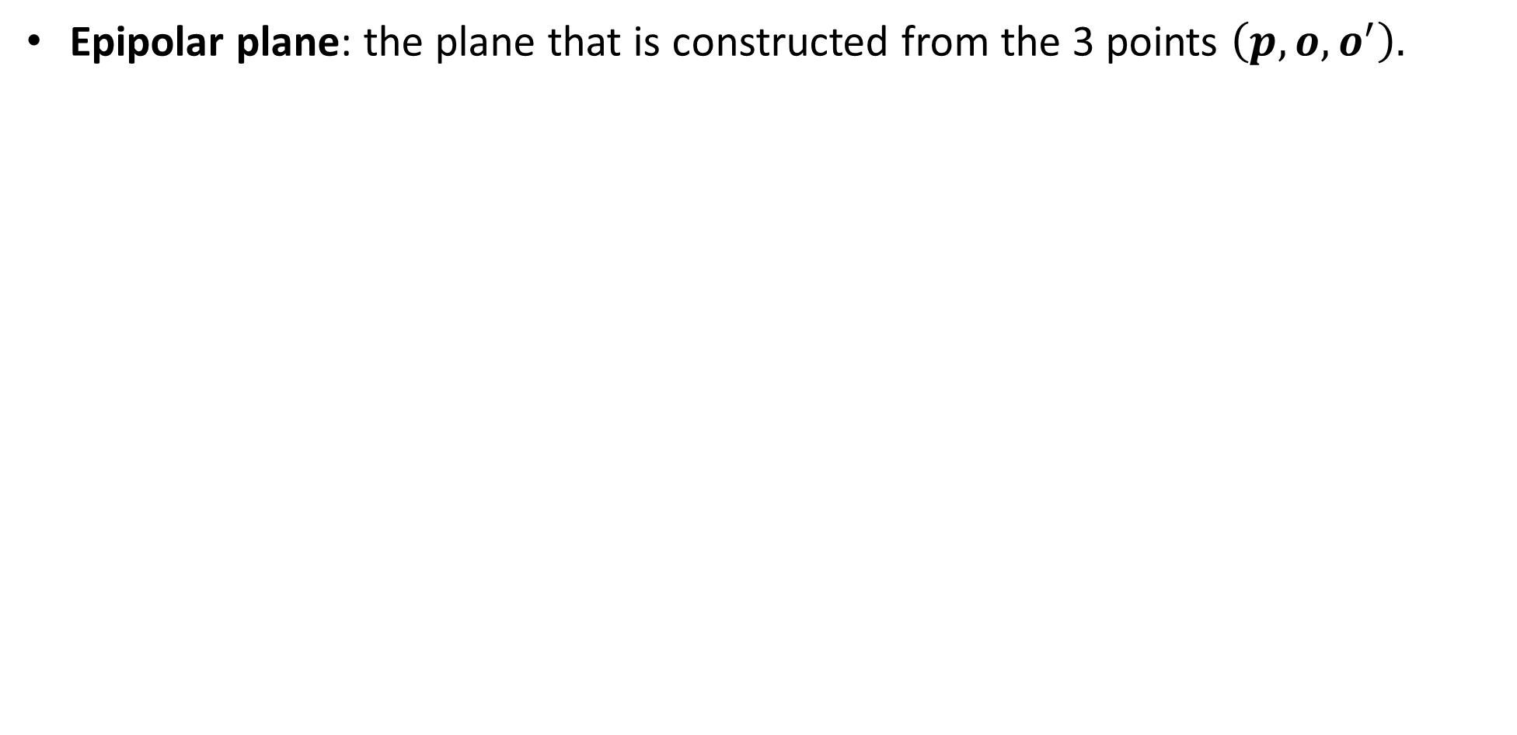
Epipolar geometry
Epipolar plane: the plane that is constructed from the 3 points $\left(p,o,o^{′}\right).$
Epipolar plane
$$I$$
$I$’

Slide 16

Epipolar geometry
Epipolar line: intersection of Epipolar plane and image plane.
Epipolar line
$$I$$
$I$’

Slide 17
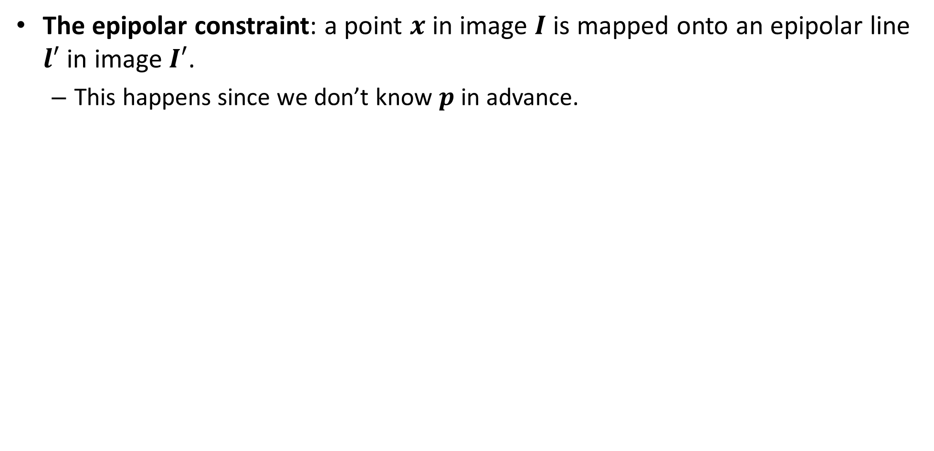
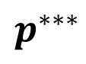
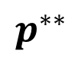
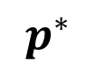
Epipolar constraint
The epipolar constraint: a point $x$ in image $I$ is mapped onto an epipolar line $l′$ in image $I′$.
This happens since we don’t know $p$ in advance.
$$p^{∗}$$
$$p^{∗∗}$$
$$p^{∗∗∗}$$
$$I$$
$I$’

Slide 18
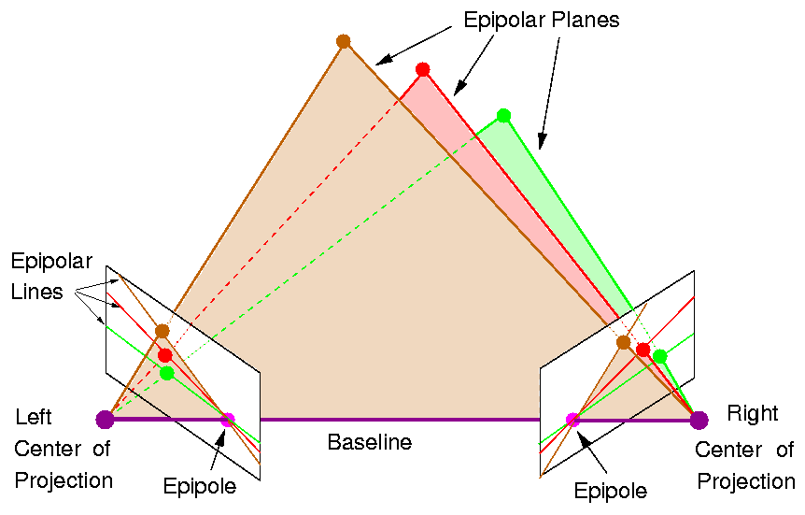
Epipolar geometry
Note: all epipolar lines pass through the epipole.

Slide 19
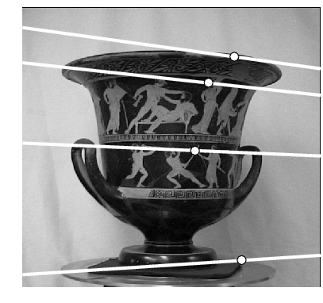
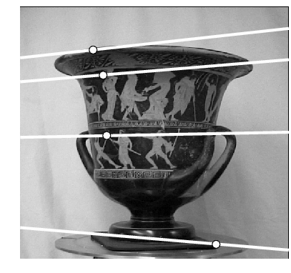
Epipolar geometry
Where is the epipole in this images?

Slide 20
Epipolar geometry
Where is the epipole in this images? The epipole doesn’t have to be inside the image!
here!

Slide 21
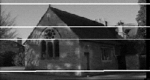
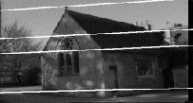
Epipolar geometry
Where is the epipole in this image?

Slide 22
Epipolar geometry
Where is the epipole in this image? The epipolar lines doesn’t converge since the baseline (translation) is parallel to the image plane!

Slide 23
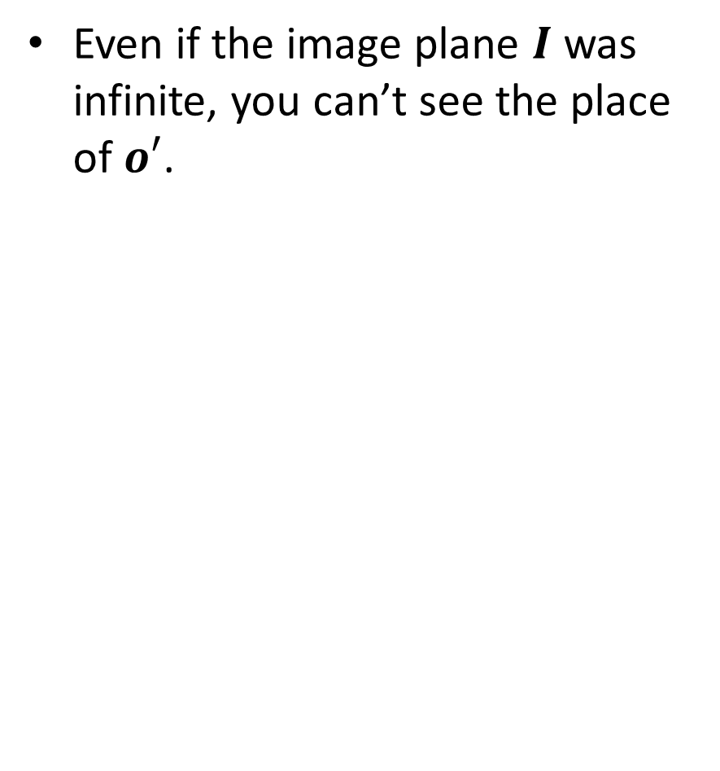
Epipolar geometry
Even if the image plane $I$ was infinite, you can’t see the place of $o′$.

Slide 24
Contents
structure from motion
Epipolar geometry
Essential matrix
Fundamental matrix
Estimating the fundamental matrix
Camera rectification
Triangulation
Stereo matching
Other 3D sensors

Slide 25
Recall: Dot Product
dot product of two orthogonal vectors is zero

Slide 26
Recall: Cross Product
Vector (cross) product takes two vectors and returns a vector perpendicular to both

Slide 27
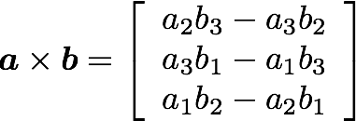
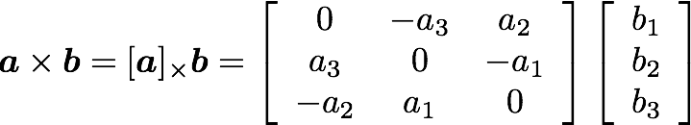
Recall: Cross Product
Can also be written as a matrix multiplication
Skew symmetric

Slide 28


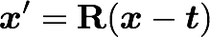
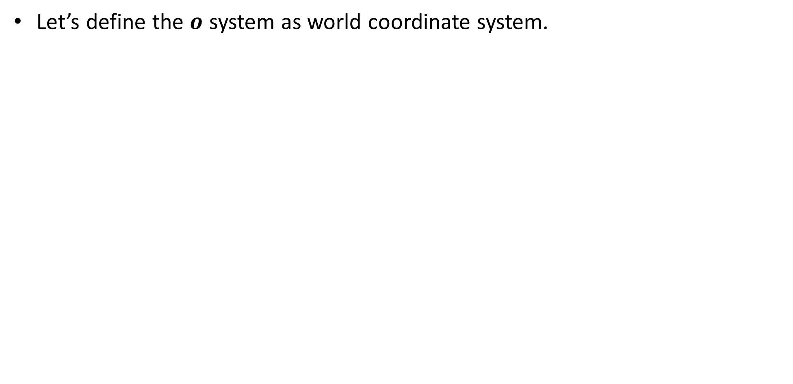

Building the essential matrix
Let’s define the $o$ system as world coordinate system.
*$t$ here is $c$ from camera calibration class

Slide 29
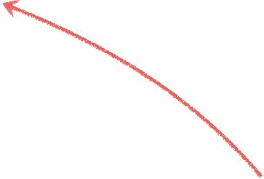
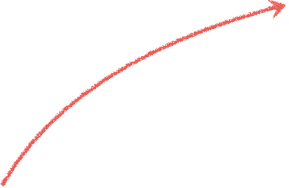

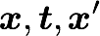
Building the essential matrix
These three vectors are coplanar

Slide 30
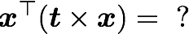
Building the essential matrix
These three vectors are coplanar

Slide 31
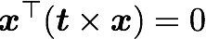
Building the essential matrix
These three vectors are coplanar

Slide 32
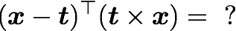
Building the essential matrix
These three vectors are coplanar

Slide 33
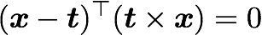
Building the essential matrix
These three vectors are coplanar

Slide 34
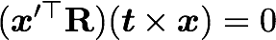
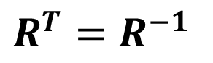
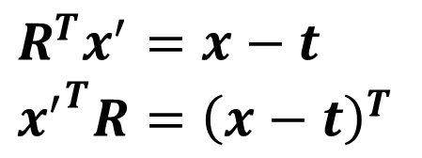
Building the essential matrix
rigid motion
coplanarity
$$R^{T}=R^{−1}$$
$$R^{T}x^{′}=x−t \\ {x^{′}}^{T}R={\left(x−t\right)}^{T}$$

Slide 35
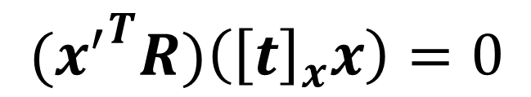
Building the essential matrix
rigid motion
coplanarity
$$R^{T}=R^{−1}$$
$$R^{T}x^{′}=x−t \\ {x^{′}}^{T}R={\left(x−t\right)}^{T}$$
$${{(x}^{′}}^{T}R)\left({\left[t\right]}_{x}x\right)=0$$

Slide 36
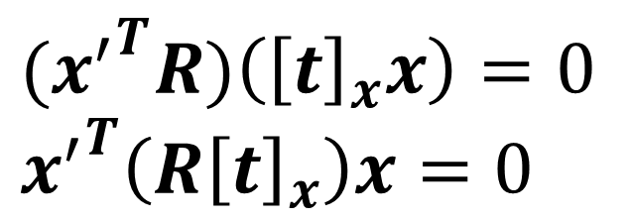
Building the essential matrix
rigid motion
coplanarity
$$R^{T}=R^{−1}$$
$$R^{T}x^{′}=x−t \\ {x^{′}}^{T}R={\left(x−t\right)}^{T}$$
$${{(x}^{′}}^{T}R)\left({\left[t\right]}_{x}x\right)=0 \\ {x^{′}}^{T}\left({R\left[t\right]}_{x}\right)x=0$$

Slide 37
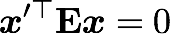
Building the essential matrix
rigid motion
coplanarity
$$R^{T}=R^{−1}$$
$$R^{T}x^{′}=x−t \\ {x^{′}}^{T}R={\left(x−t\right)}^{T}$$
$${{(x}^{′}}^{T}R)\left({\left[t\right]}_{x}x\right)=0 \\ {x^{′}}^{T}\left({R\left[t\right]}_{x}\right)x=0$$

Slide 38

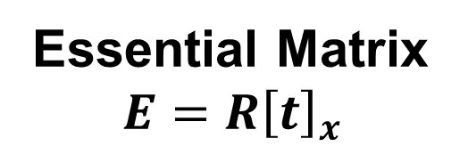
Building the essential matrix
rigid motion
coplanarity
$$R^{T}=R^{−1}$$
$$R^{T}x^{′}=x−t \\ {x^{′}}^{T}R={\left(x−t\right)}^{T}$$
$${{(x}^{′}}^{T}R)\left({\left[t\right]}_{x}x\right)=0 \\ {x^{′}}^{T}\left({R\left[t\right]}_{x}\right)x=0$$
Essential Matrix
$$E={R\left[t\right]}_{x}$$

Slide 39
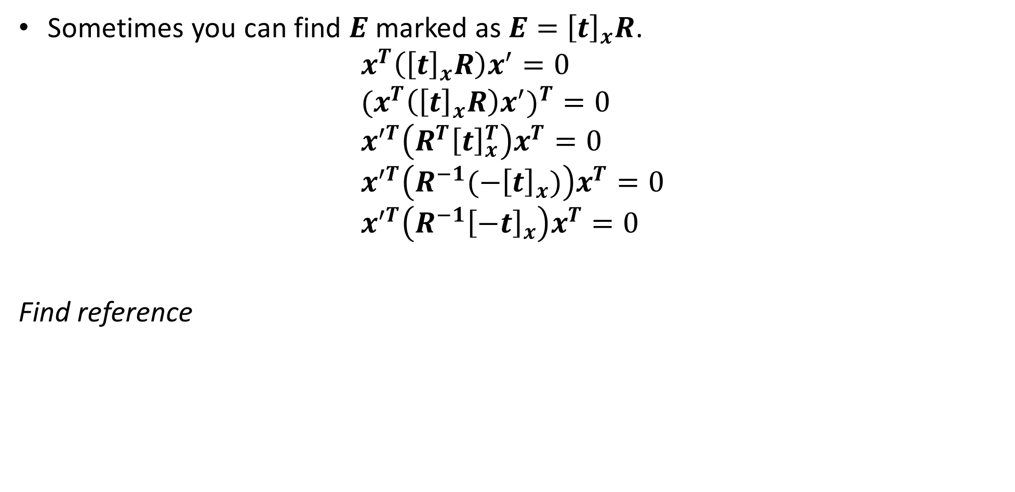
Side note: another representation
Sometimes you can find $E$ marked as $E=$ ${\left[t\right]}_{x}R$.
$$x^{T}\left({\left[t\right]}_{x}R\right)x^{′}=0 \\ {(x}^{T}\left({\left[t\right]}_{x}R\right)x^{′})^{T}=0 \\ x^{′T}\left({R^{T}\left[t\right]}_{x}^{T}\right)x^{T}=0 \\ x^{′T}\left(R^{−1}(−{\left[t\right]}_{x})\right)x^{T}=0 \\ x^{′T}\left(R^{−1}{\left[−t\right]}_{x}\right)x^{T}=0$$
Find reference

Slide 40
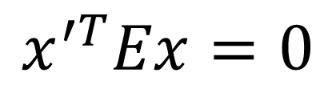
properties of the E matrix
(points in normalized image coordinates)
Essential matrix definition
$$x^{′T}Ex=0$$

Slide 41
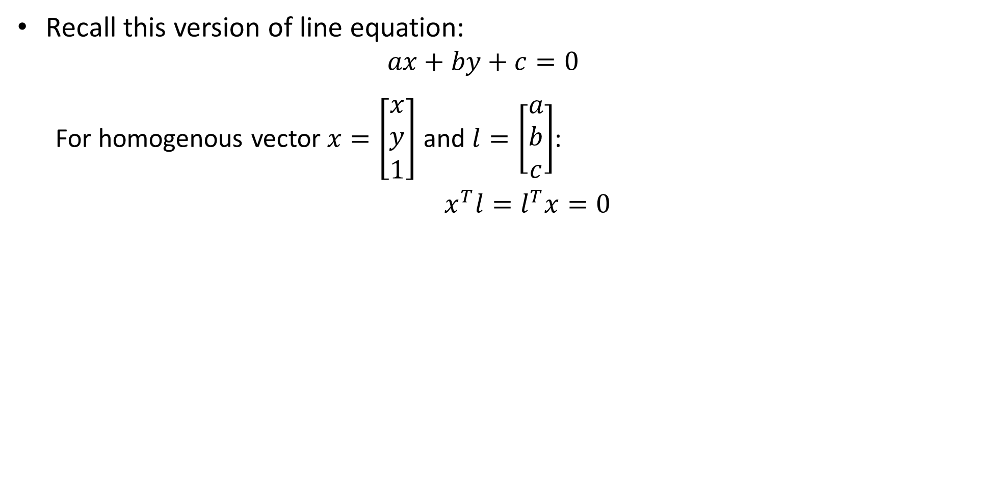
Epipolar lines equation
Recall this version of line equation:
$$ax+by+c=0$$
For homogenous vector$x=\left[\begin{aligned}x \\ y \\ 1\end{aligned}\right]$ and $l=\left[\begin{aligned}a \\ b \\ c\end{aligned}\right]$:
$x^{T}l=l^{T}x=0$

Slide 42
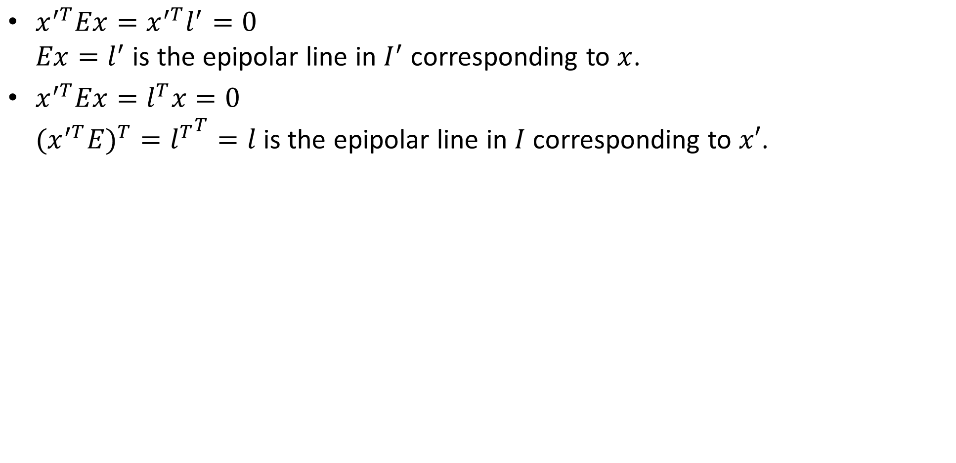
Epipolar lines equation
$x^{′T}Ex=x^{′T}l^{′}=0$ $Ex=l^{′}$ is the epipolar line in $I^{′}$ corresponding to $x$.
$x^{′T}Ex=l^{T}x=0$ ${{(x}^{′T}E)}^{T}={l^{T}}^{T}=l$is the epipolar line in $I$corresponding to $x′$.

Slide 43
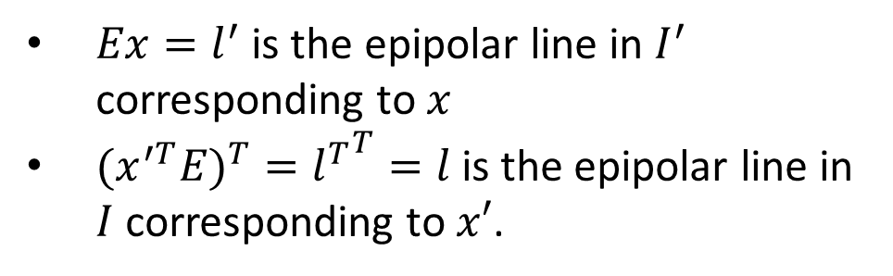
properties of the E matrix
Full proof for the epipolar lines can be found here:
http://www.cs.cornell.edu/courses/cs4670/2015sp/lectures/lec21_stereo_web.pdf
(points in normalized image coordinates)
Essential matrix definition
$$x^{′T}Ex=0$$
$Ex=l^{′}$ is the epipolar line in $I^{′}$ corresponding to $x$
${{(x}^{′T}E)}^{T}={l^{T}}^{T}=l$is the epipolar line in $I$corresponding to $x′$.
Epipolar lines

Slide 44
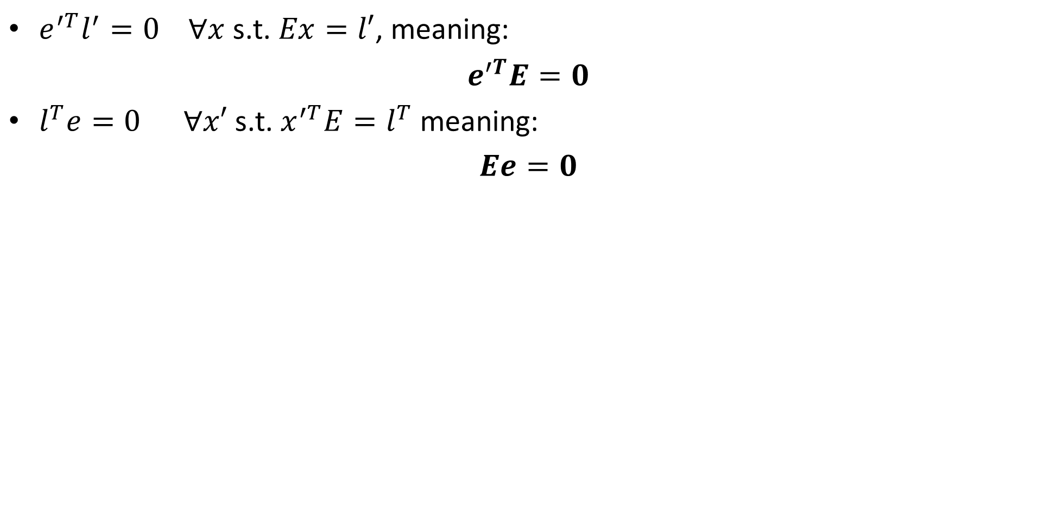
Epipolar lines equation
$e^{′T}l^{′}=0$ $∀x$s.t. $Ex=l′$, meaning:
$e^{′T}E=0$
$l^{T}e=0 ∀x′$s.t. $x^{′T}E=l^{T}$meaning:
$Ee=0$

Slide 45
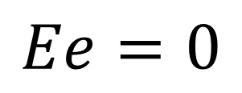
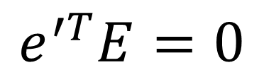
properties of the E matrix
(points in normalized image coordinates)
Essential matrix definition
$$x^{′T}Ex=0$$
$Ex=l^{′}$ is the epipolar line in $I^{′}$ corresponding to $x$
${{(x}^{′T}E)}^{T}={l^{T}}^{T}=l$is the epipolar line in $I$corresponding to $x′$.
Epipolar lines
Epipoles
$$e^{′T}E=0$$
$$Ee=0$$

Slide 46
Contents
structure from motion
Epipolar geometry
Essential matrix
Fundamental matrix
Estimating the fundamental matrix
Camera rectification
Triangulation
Stereo matching
Other 3D sensors

Slide 47
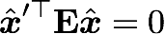


Fundamental matrix
The Essential matrix operates on image points expressed in
normalized coordinates (points have been aligned (normalized) to camera coordinates)
camera point
image point

Slide 48




Fundamental matrix
The Essential matrix operates on image points expressed in
normalized coordinates (points have been aligned (normalized) to camera coordinates)
camera point
image point
Writing out the epipolar constraint in terms of image coordinates
Essential Matrix
$$F=K^{′−T}EK^{−1}$$

Slide 49





properties of the F matrix
All of the below functions works with $F$ and un-normalized points the same!
(points in un-normalized image coordinates)
Fundamental matrix definition
$$x^{′T}Fx=0$$
$Fx=l^{′}$ is the epipolar line in $I^{′}$ corresponding to $x$
${{(x}^{′T}F)}^{T}={l^{T}}^{T}=l$is the epipolar line in $I$corresponding to $x′$.
Epipolar lines
Epipoles
$$e^{′T}F=0$$
$$Fe=0$$

Slide 50
Contents
structure from motion
Epipolar geometry
Essential matrix
Fundamental matrix
Estimating the fundamental matrix
Camera rectification
Triangulation
Stereo matching
Other 3D sensors

Slide 51


Estimating F
If we don’t know K₁, K₂, R, or t, can we estimate F for two images?
Yes, given enough correspondences

Slide 52
Estimating F – 8-point algorithm
The fundamental matrix F is defined by
for any pair of matches x and x’ in two images.
Let x=(u,v,1)^{T} and x’=(u’,v’,1)^{T},
each match gives a linear equation

Slide 53
8-point algorithm
Like with homographies, instead of solving , we seek f to minimize , least eigenvector of .

Slide 54
8-point algorithm – Problem?
F should have rank 2
To enforce that F is of rank 2, F is replaced by F’ that minimizes subject to the rank constraint.
This is achieved by SVD. Let , where
, let
then is the solution.

Slide 55
8-point algorithm
Pros: it is linear, easy to implement and fast
Cons: susceptible to noise.
Solutions: (all out of scope)
normalized 8 points algorithm.
7 points algorithm.
Finding K,K’ with single camera intrinsics calibration and then search for E (only 5 DOFs instead of 8/7).

Slide 56
Contents
structure from motion
Epipolar geometry
Essential matrix
Fundamental matrix
Estimating the fundamental matrix
Camera rectification
Triangulation
Stereo matching
Other 3D sensors

Slide 57
Structure and motion
 | Structure (3D model of world) | Motion (6 DOFs of cameras) | Measurements
Pose Estimation (camera pose estimation) | known | estimate | 3D to 2D correspondences
Triangulation | estimate | known | 2D to 2D correspondences
3D reconstruction | estimate | Estimated! | 2D to 2D correspondences + triangulation
We’ve found the motion, let’s find the structure – back to triangulation problem!

Slide 58


How would you reconstruct 3D points?
Left image
Right image

Slide 59
How would you reconstruct 3D points?
Left image
Right image
Select point in one image

Slide 60
How would you reconstruct 3D points?
Left image
Right image
Select point in one image
Form epipolar line for that point in second image

Slide 61
How would you reconstruct 3D points?
Left image
Right image
Select point in one image
Form epipolar line for that point in second image
Find matching point along line (how?)

Slide 62

How would you reconstruct 3D points?
$$Z=10m$$
Left image
Right image
Select point in one image
Form epipolar line for that point in second image
Find matching point along line (how?)
Perform triangulation (how?)

Slide 63
Stereo image rectification
Out of scope…
Let’s say the images comes rectified (as in the yellow samples).

Slide 64


Original stereo pair
After rectification

Slide 65
Contents
structure from motion
Epipolar geometry
Essential matrix
Fundamental matrix
Estimating the fundamental matrix
Camera rectification
Triangulation
Stereo matching
Other 3D sensors

Slide 66

triangulation

Slide 69
triangulation
Objects that are close move more or less?

Slide 70
triangulation
The amount of horizontal movement is inversely proportional to the distance from the camera.
The amount of horizontal movement == disparity.
Distance from the camera == depth (or Z).

Slide 71

triangulation

Slide 72
Contents
structure from motion
Epipolar geometry
Essential matrix
Fundamental matrix
Estimating the fundamental matrix
Camera rectification
Triangulation
Stereo matching
Other 3D sensors

Slide 73


Stereo Block Matching
Left
Right
scanline
Matching cost
disparity
Slide a window along the epipolar line and compare contents of that window with the reference window in the left image
Matching cost: SSD or normalized correlation

Slide 74

SSD

Slide 75

Normalized cross-correlation

Slide 76


Effect of window size
W = 3
W = 20

Slide 77
Effect of window size
W = 3
W = 20
Smaller window
+ More detail
- More noise
Larger window
+ Smoother disparity maps
- Less detail
- Fails near boundaries

Slide 78




When will stereo block matching fail?

Slide 79
When will stereo block matching fail?
textureless regions
repeated patterns
specularities

Slide 80



Block matching
Ground truth
What are some problems with the result?

Slide 81
How can we improve depth estimation?

Slide 82
How can we improve depth estimation?
Too many discontinuities.
We expect disparity values to change slowly.
Let’s make an assumption:
depth should change smoothly

Slide 83

Stereo matching as … Energy Minimization
What defines a good stereo correspondence?
Match quality
Want each pixel to find a good match in the other image
Smoothness
If two pixels are adjacent, they should (usually) move about the same amount

Slide 84

energy function
(for one pixel)
{
{
data term
smoothness term
Want each pixel to find a good match in the other image
Adjacent pixels should (usually) move about the same amount
(block matching result)
(smoothness function)

Slide 85



data term
SSD distance between windows centered at I(x, y) and J(x+ d(x,y), y)

Slide 86




SSD distance between windows centered at I(x, y) and J(x+ d(x,y), y)
smoothness term
: set of neighboring pixels
4-connected neighborhood
8-connected neighborhood

Slide 87



smoothness term
L₁ distance
“Potts model”

Slide 88

Dynamic Programming
One possible solution…
Can minimize this independently per scanline using dynamic programming (DP)
: minimum cost of solution such that d(x,y) = d

Slide 89

Match only
Match & smoothness (via graph cut)
Ground Truth
Y. Boykov, O. Veksler, and R. Zabih, Fast Approximate Energy Minimization via Graph Cuts, PAMI 2001

Slide 90
Contents
structure from motion
Epipolar geometry
Essential matrix
Fundamental matrix
Estimating the fundamental matrix
Camera rectification
Triangulation
Stereo matching
Other 3D sensors

Slide 91


Other types of 3D sensors
LIDAR, which stands for Light Detection and Ranging (or light radar), is a remote sensing method that uses light in the form of a pulsed laser to measure ranges.
Most known: velodyne projector.

Slide 92


Other types of 3D sensors
Structured light

Slide 93

Other types of 3D sensors
Coded light
Realsense SR305
https://www.youtube.com/watch?v=PluL7WTlKrM

Slide 94




Other types of 3D sensors
Light Coding
Used in Kinect v1- Kinect for xbox 360.
Iphone x front camera

